Slide 1



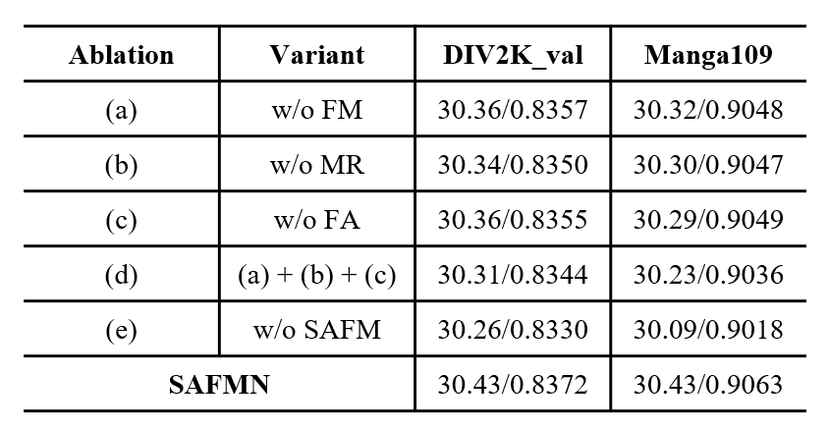
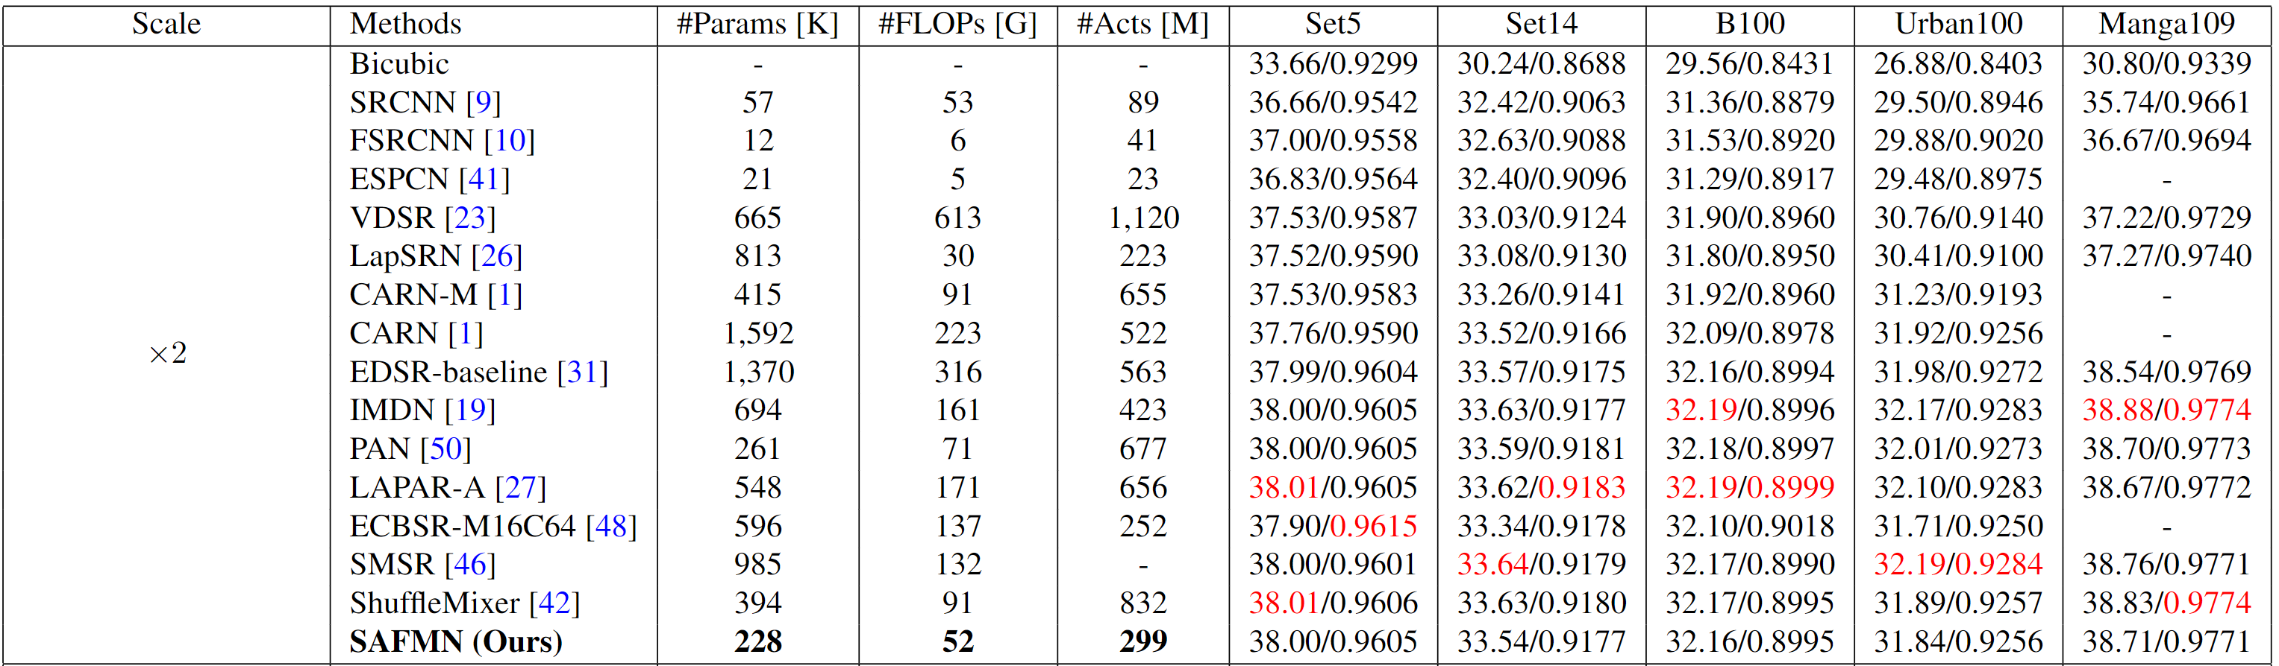
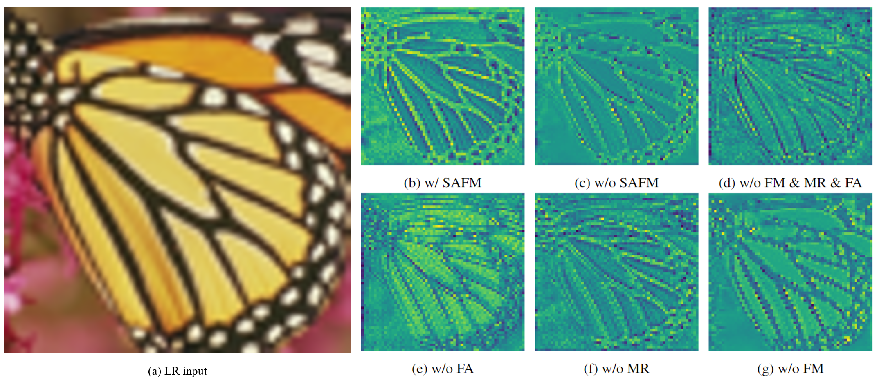
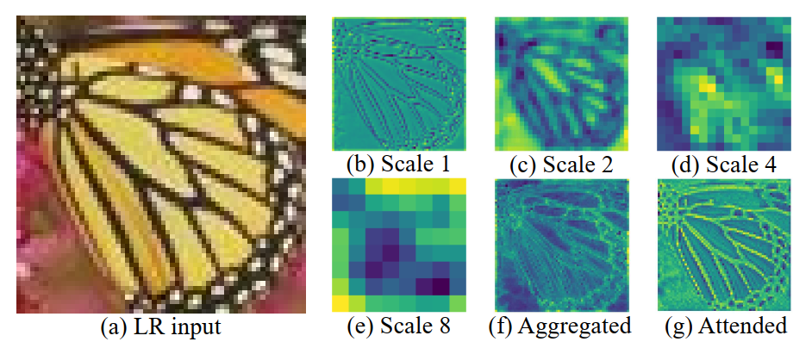

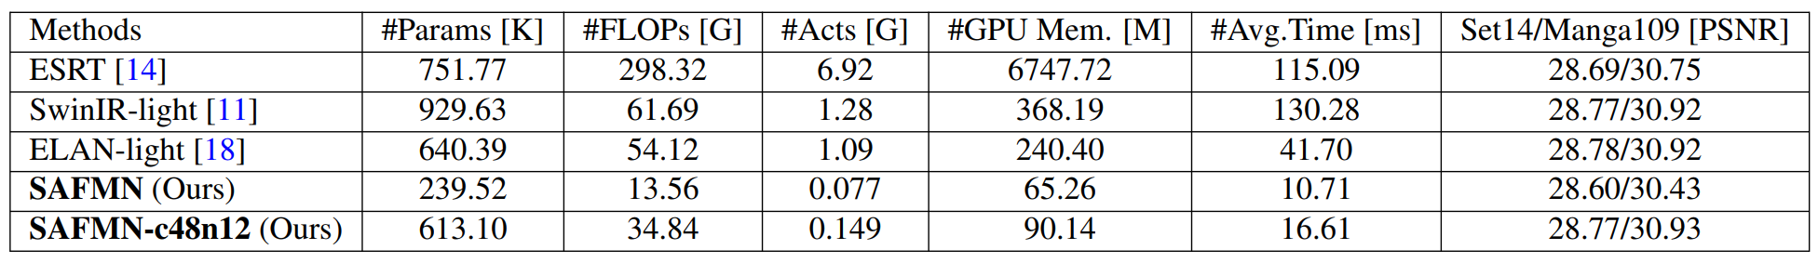
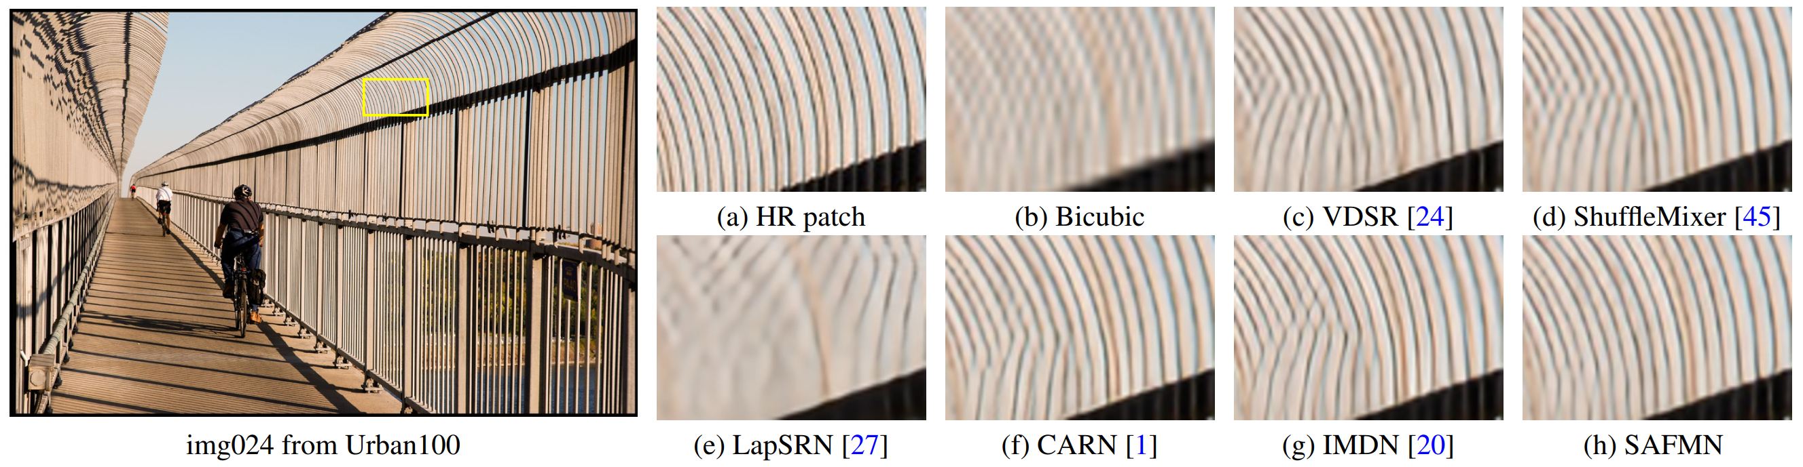
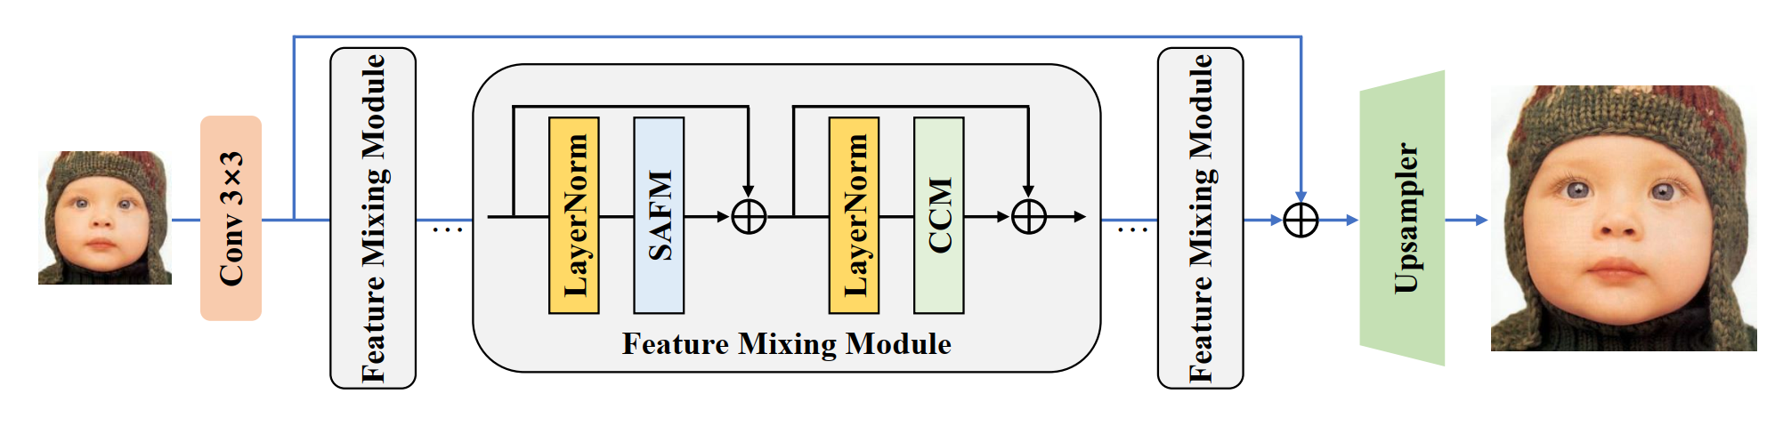
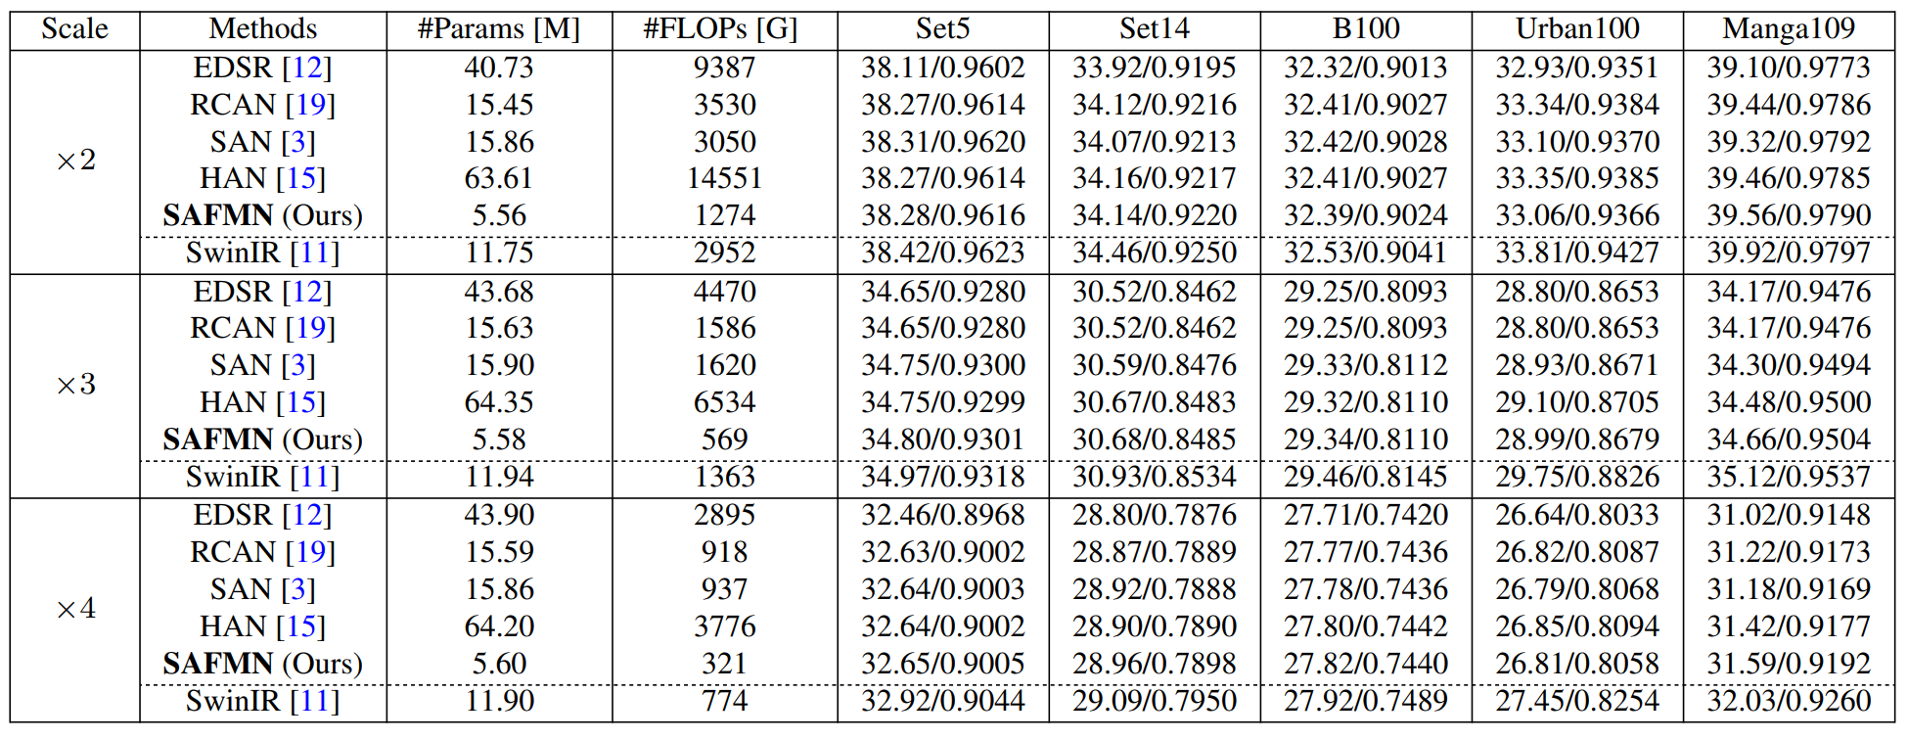



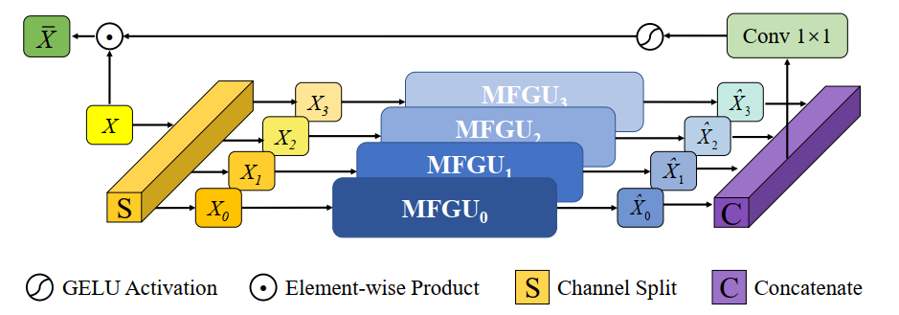
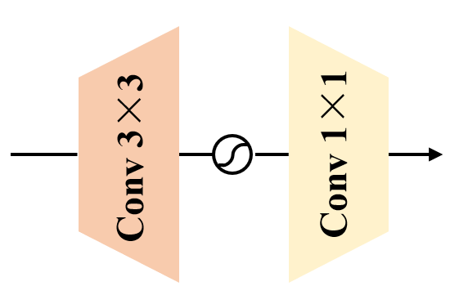



Spatially-Adaptive Feature Modulation for Efficient Image Super-Resolution
Long Sun, Jiangxin Dong, Jinhui Tang, and Jinshan Pan
Motivation & Contribution
Experiments & Results
3. Effectiveness of the SAFM
Motivations
The trade-off between reconstruction performance and model efficiency of existing lightweight SR methods still has significant room for improvement.
Recent ViT-based SR models achieve good performance with high computational cost, which is incompatible with efficient SR design.
Contributions
We develop an efficient feature modulation mechanism upon a grouped multi-scale representation to learn feature dependencies, which absorbs CNN-like efficiency and transformer-like adaptability.
We present a compact convolutional channel mixer that encodes local contextual information and performs channel mixing simultaneously.
1. Comparison with lightweight SR methods
1.1 Quantitative results
1.2 Comparison with the challenge winners
(a) Illustration of learned deep features from ablations
(b) Illustration of learned multi-scale features in the SAFM module
4. Qualitative comparisons
The Proposed Method
4.1 Efficient SR results.
1.3 Comparison with ViT-based SR methods
Network architecture
2. Comparison with classical image SR methods
4.2 Real-world SR results.
Spatially-Adaptive Feature Modulation
Convolutional Channel Mixer
LR input
DiffBIR
SAFMN-Real

